Slide 1


Introduction to Circuits Analysis
by Andrew G. Bell
abell118@ivytech.edu
(260) 481-2288
Lecture 2

Slide 2
CHAPTER 2
Electrical Quantities
and Components

Slide 3
Conductance
Definition: Ability to allow current to flow
Relationship to Resistance: Opposite of resistance
Unit of Measure: Siemens (S)

Slide 4
Electrical Units and Abbreviations
Unit Measure Symbol
Potential Volt V
Current Ampere A
Resistance Ohm Ω
Conductance Siemens S

Slide 5
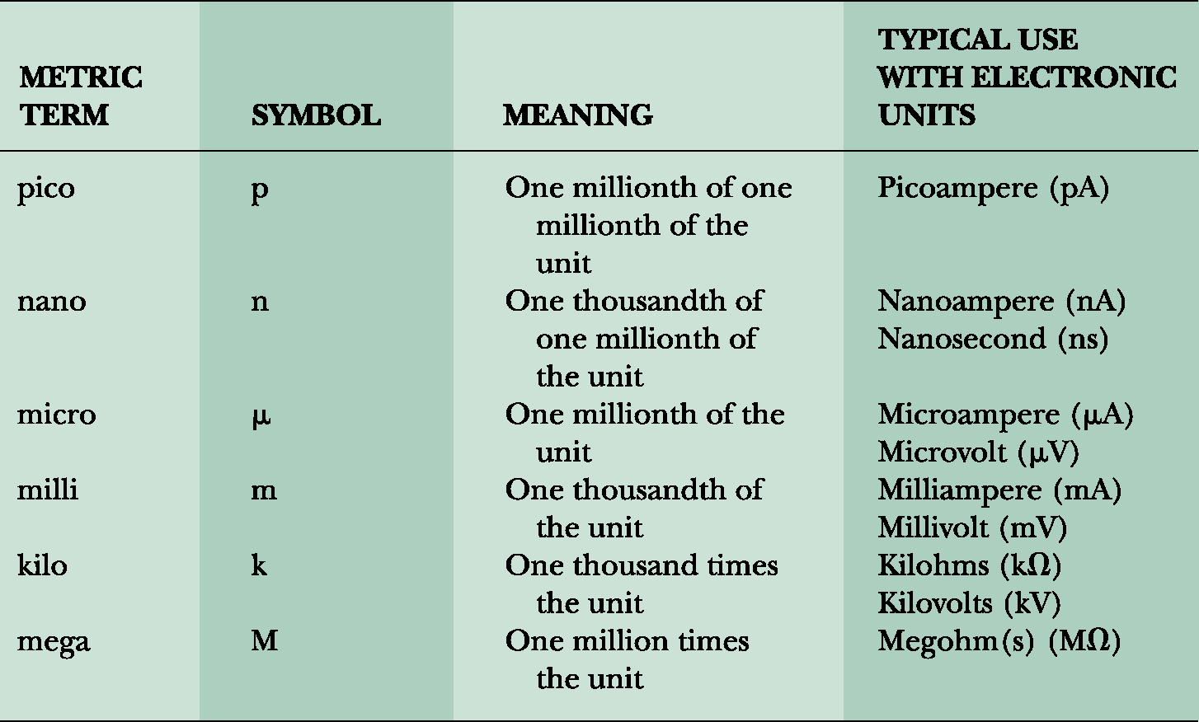
Familiar Metrics

Slide 6
Conductors
Function:
  To carry electrical energy from one point to another or to provide a path for electrical current flow between components or circuits
Numerous Types of Conductors
  Determined by the nature of application and the amount of current to be carried

Slide 7
Conductors (cont.)
Ways of classifying conductors include:
  Type of metal used
  Size of the wire
  Form of the wire (solid, stranded, or braided)
  Number of conductors used
  Insulation characteristics

Slide 8
Superconductivity
All conductors have some resistance at normal operating temperatures.
Superconductivity:
  Current flow through a material with nearly zero resistance
  Only occurs in certain materials
  Only occurs at extremely cold temperatures (e.g., –273°C)

Slide 9
Superconductivity (cont.)
Certain ceramic materials have very low resistance at temperatures much higher than absolute zero (–273°C).
  Low resistance at higher temperatures makes it easier to take advantage of superconductivity.
Some future possibilities:
  More efficient motors and generators
  Faster computers

Slide 10
Physical Factors of Conductors
Factors that influence resistance:
  Type of material
  Length of conductor
  Cross-sectional area of wire
  Temperature of wire
    Temperature coefficients

Slide 11
Physical Factors of Conductors (cont.)
Resistivity
  Characteristic resistance in ohms of a given material per standard length (meters or mils) and cross-sectional area (square meters or circular mils)
  Different materials have different resistivity characteristics.

Slide 12
Characteristics of Wire
Standardized wire sizing by the American Standard Wire Gauge (AWG)
Current-handling capabilities
Types: Stranded and solid
Resistance: Determined by material, length and cross-sectional area of the wire

Slide 13
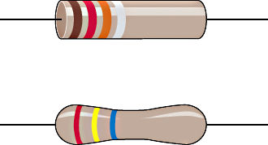
Resistors
Definition:
  Devices which oppose current
Purpose:
  To limit current and divide voltage
Types:
  Fixed
  Variable

Slide 14
Resistor Size
The physical size of the resistor determines its ability to handle heat.
The difference between a carbon or a chip resistor and a wire-wound resistor is merely its ability to handle current flow.
Wire-wound resistors are designed to handle more heat than carbon or chip resistors.

Slide 15
Common Resistor Types
Fixed Resistors:
  One value only
  Common values available
  Value determined by color coding
  Variety of wattage ratings
  Quality ratings vary widely

Slide 16
Variable Resistors
Potentiometer:
  Variable from 0 ohms to labeled value
  Popular due to flexibility
  Found in use as volume controls
  Physical sizes available vary widely
  Resistance values vary widely
  Resistance value generally stamped

Slide 17
Resistor Type Summary
Wire-wound: High wattage
Potentiometer: Variable resistance values
Rheostat: Alternative to potentiometer
Chip Resistor: Small size, common in compact circuits
Carbon Composition: Fixed value, common, inexpensive
Precision: Accurately controlled values

Slide 18
The Resistor Color Code
Purpose: Indicate value efficiently
Values: Standard values available
Color Bands: Used to indicate value
Tolerance: Indicates acceptable variance

Slide 19
Four Band Color Code
First band indicates first significant number in value.
Second band indicates second significant number in value.
Third band indicates multiplier.
Fourth band indicates tolerance.

Slide 20
Example Color Coding

Slide 21
Five Band Color Code
First band indicates first significant number in value.
Second band indicates second significant number in value.
Third band indicates third significant number in value.
Fourth band indicates multiplier.
Fifth band indicates tolerance.

Slide 22
Example Color Coding

Slide 23
Resistor Tolerance
Definition: The range of acceptable values
Common tolerance values for four banded resistors: 20%, 10%, 5%
Precision tolerance values for five banded resistors: 2%, 1%, 0.5%, 0.25%, 0.1%

Slide 24
Example of Tolerance
Resistor Colors: Brown, Black, Brown, Gold
Brown, Black, Brown = 100 ohms
Gold = +/-5%
Upper Limit = 100 + 5 = 105 ohms
Lower Limit = 100 – 5 = 95 ohms

Slide 25
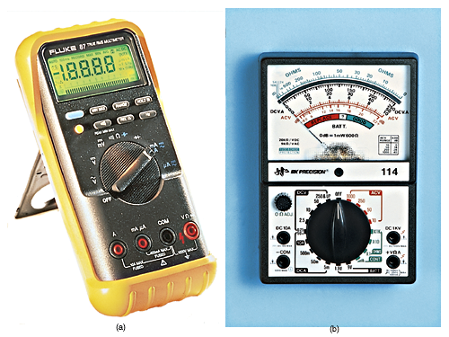
Typical Meters

Slide 26
Measuring Voltage with Meters
Set meter to voltage function and proper range.
Connect the meter test leads to the two points you wish to measure (across the device). The red or positive lead should be closest to the positive terminal of the source.
The measured voltage will be displayed.

Slide 27
Measuring Resistance with Meters
Remove power source.
Set meter to resistance function and proper range.
Meter leads are used like voltmeter.
Isolate the component to be measured.
Precautions: Power must be OFF!

Slide 28
Measuring Current with Meters
Set meter to voltage function and proper range. Change position of the red lead for most meters.
Break the circuit and insert meter test leads in line (series) with the current path.
Precaution: Connection to circuit is critical!

Slide 29
Schematic Symbols
V
Voltmeter:
Ohmmeter:
Ammeter :
Ω
A

Slide 30
The Schematic Diagram
Wiring Conventions:
  Connection/No connection
The Switch
  Basic On/Off
The Resistor:
  Fixed and Variable

Slide 31
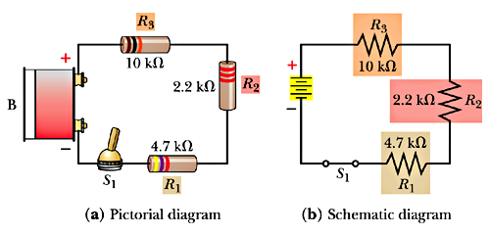
The Circuit

